Slide 1

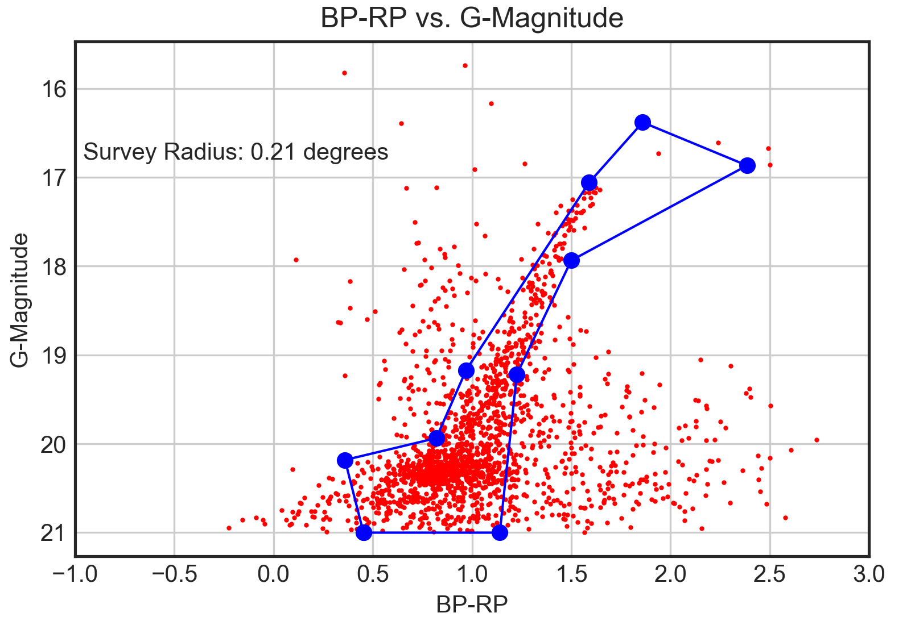
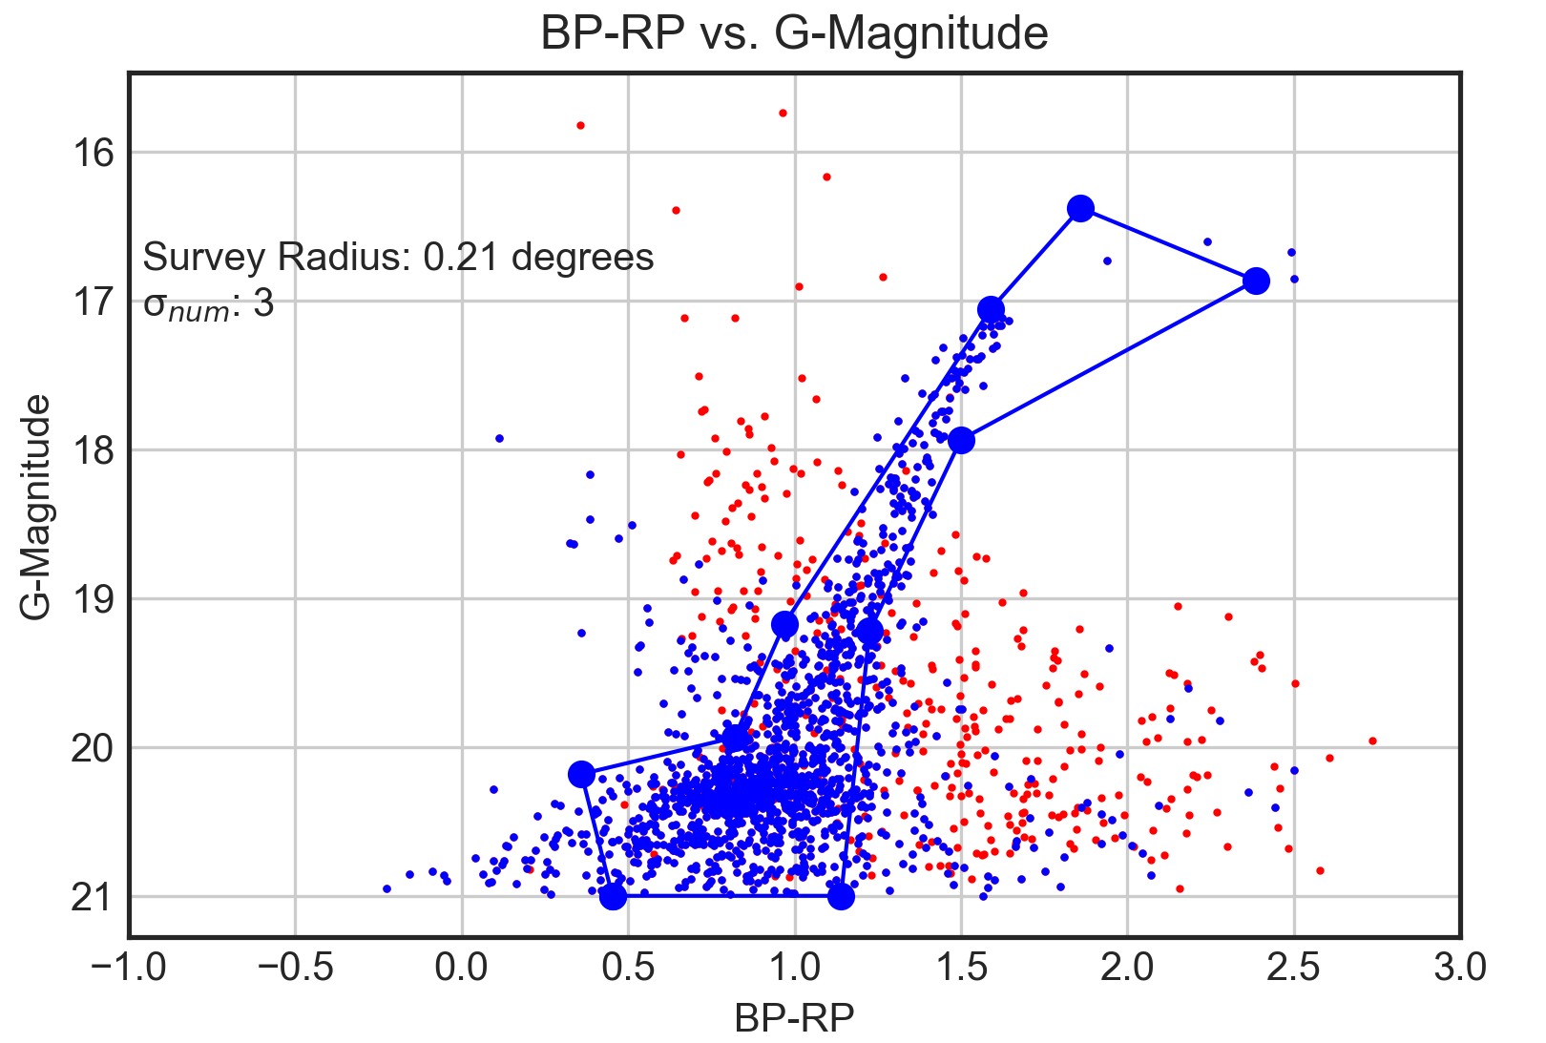
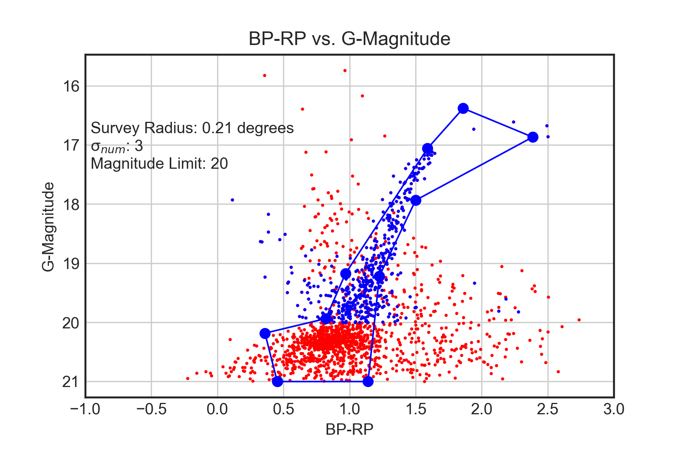
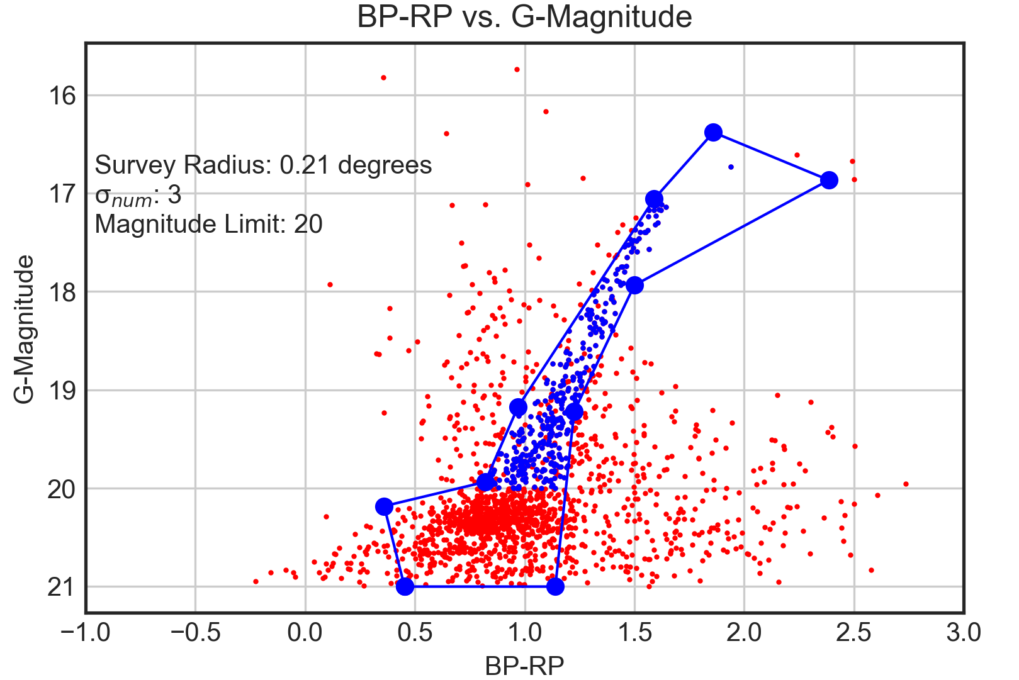
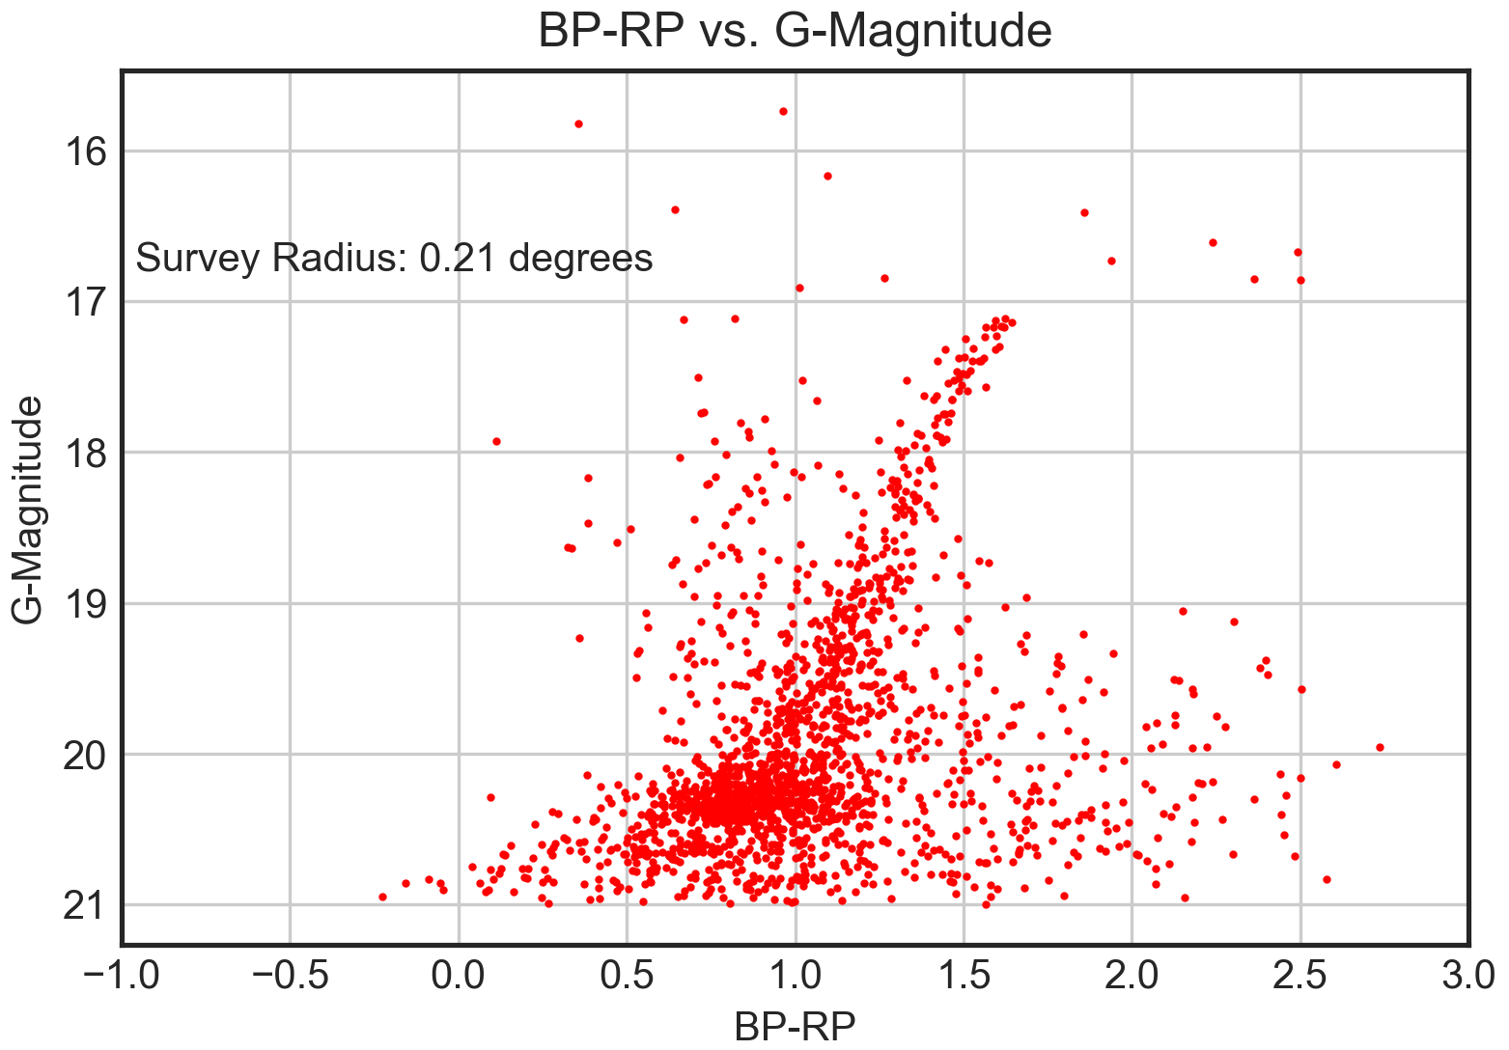
A Search for Tidal Tails in Carina
Sean MacBride¹, Carlton Pryor²
¹ Wheaton College Massachusetts, ² Rutgers University
Abstract
Methods
We searched for evidence of tidal stripping in the spatial structure of the dwarf satellite galaxy Carina using data from the European Space Agency satellite Gaia. The satellites of our Milky Way Galaxy are remnants of clues to its birth. Carina is intriguing because it has a more extended star formation history than other dwarf satellite galaxies of similar mass. In larger satellite galaxies the gas is retained longer, and this allows star formation to continue. The star formation history of Carina suggests that it was once more massive, and has been truncated by the gravitational forces of the Milky Way or some other satellite. Gaia data provides precise photometry, proper motions, parallaxes, and positions for over one billion stars. The proper motion and parallax data are especially intriguing, as measurements of such precision were not previously available for most of the stars. We selected potential members of Carina based on proper motion and position in the color-magnitude diagram over an area of the sky ~6.5 degrees across, and used these stars to search for low-surface-density indications of tidal interaction, such as non-axisymmetric distortions of the outer regions of Carina or extended tails along the direction of orbital motion that would indicate tidally-removed stars.
Our data was processed using selections on photometry, positional data, and proper motion. Using a tight proper motion selection, photometric bounds on the data were determined.
Upon imposing these bounds, a proper motion selection was imposed on the entire data set.
Next, a magnitude limit was imposed, to allow for observation of brighter or dimmer samples.
Finally, the photometric and semimajor axes bounds were imposed. The semimajor axes bound was designed to include only member stars that had a semimajor axis equal or smaller than the survey radius.
Fig. 2 – Photometric selection based on the proper motion selection
Fig. 3 – Member stars selected by proper motion in blue
Fig. 4 – Member stars selected by proper motion and magnitude in blue
Fig. 5 – The final selection of member stars in blue
Results
Background
Gaia is a European Space Agency satellite that was launched in 2013. It is designed to survey over a billion astronomical objects. The Gaia team recently released the second major data release, DR-2. The data collected includes photometric, proper motion, parallax, and positional data, among others. The proper motion and photometric data were the most important in our search for tidal tails in Carina, as it allowed us to limit our data to only member stars.
Carina is a dwarf satellite galaxy. Satellite galaxies are remnants of the formation of the Milky Way that did not collapse onto the disk of the galaxy, instead of orbiting the galactic center. Carina lies low on the galactic latitudes, and observations are contaminated with field stars. Despite this, we are still able to determine member stars by photometric, motion, and parallax parameters. In observing the photometric diagrams of Carina, the red clump and giant branch are visible.
This would indicate that Carina was once relatively massive, but the low member star counts show otherwise. One explanation for this is that a large amount of Carina member stars were tidally stripped from the galaxy. This would be a consequence of an interaction with another massive object. We are looking for large and small scale structures around Carina that would indicate a tidal interaction with Carina.
Conclusions
References
Gaia Collaboration, Helmi, A., van Leeuwen, F., et al. 2018b, A&A, in press (arXiv:1804.09381)
Muñoz, R. R., Majewski, S. R., Zaggia, S., et al. 2006, ApJ, 649, 201
Gaia Collaboration, Brown, A.G.A., Vallenari, A., et al. 2018a, A&A, in press (arXiv:1804.09365)
Matplotlib
Rutgers University – New Brunswick
Jupyter
This project has been supported by funding from National Science Foundation grant PHY-1560077.
Fig. 1 – Photometric diagram
Notes:
Font Sizes: 84, 56, 42, 32

